Slide 1
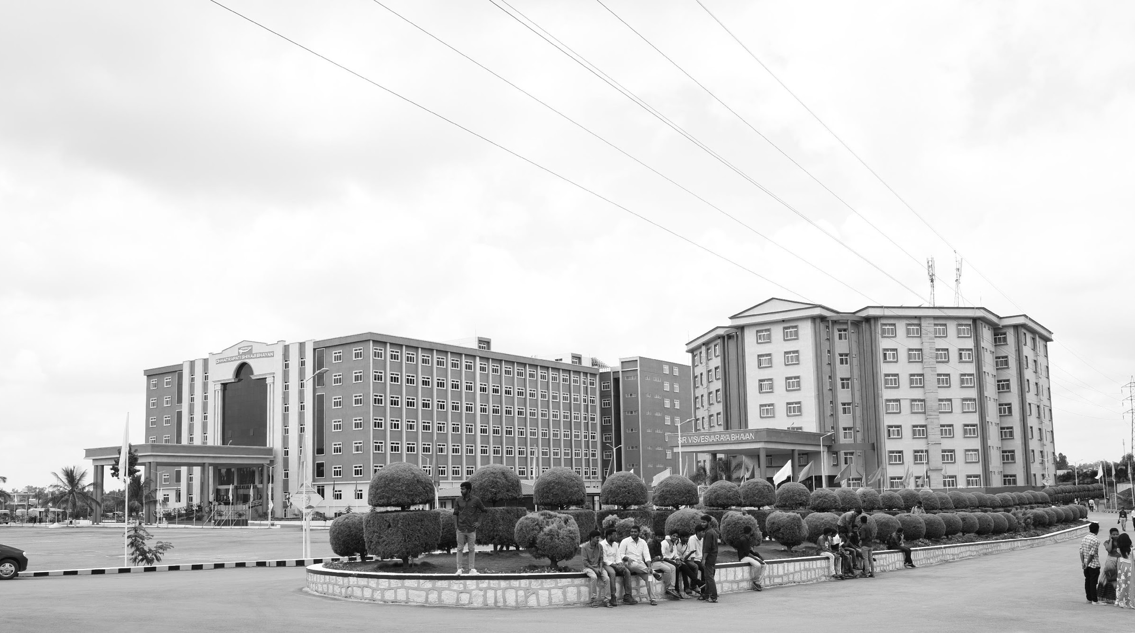

Design and performance analysis of III-V heterostructure for DNA detection
Mid-Review 1/2/3
Major Project
AY 2021-25
GITAM (Deemed-to-be) University
Project Team:
D Bhanuprakash
Bharath S N
Maruthi M
Department of Electrical Electronics and Communication Engineering
Project Mentor:
Mr. Girish Shankar Mishra
Project In-charge:
Dr Ambar Bajpai
www.gitam.edu

Slide 2
Objective and Goals
Objective
Design Objective: To design and develop a III-V semiconductor heterostructure device for detecting DNA molecules. The design should focus on leveraging the unique properties of III-V materials (such as GaAs, InP) to create a highly sensitive and efficient DNA sensor.
Performance Objective: To analyze and evaluate the performance of the designed heterostructure in terms of sensitivity, selectivity, stability, and response time in detecting DNA sequences. The aim is to improve upon existing detection methods by demonstrating enhanced device performance under various operational conditions.
Goals
Main Goals
Development of High-Sensitivity DNA Detection Devices
Analysis of Electrical and Optical Characteristics
Integration with Biosensing Mechanisms
Performance Validation for Biosensing Applications
Additional Goals
Miniaturization and Scalability
Optimization of Surface Functionalization
Environmental and Cost Considerations
Broader Applications in Biomedical Fields

Slide 3
Project Plan
Phase | Timeline | Activities
Project Planning | Week 1 - Week 2 | Literature review, defining objectives, and preparing the research framework
Material Selection | Week 3 - Week 4 | Selecting III-V compounds and functionalization materials
Heterostructure Design | Week 5 - Week 7 | Designing and simulating the heterostructure for optimal DNA detection
Fabrication and Functionalization | Week 8 - Week 10 | Fabricating the heterostructure and functionalizing the surface
Performance Analysis | Week 11 - Week 13 | Testing sensitivity, specificity, LOD, and response time
Optimization | Week 14 - Week 15 | Refining the design and improving performance metrics
Report Writing | Week 16 - Week 18 | Documenting results and preparing the final project report

Slide 4
Literature Survey
Key Publications
1). Impact of InGaN Notch on Sensitivity in Dielectric Modulated Dual Channel GaN MOSHEMT for Label-Free Biosensing
Authors: Girish Shankar Mishra, N. Mohankumar, Sankalp Kumar Singh (2023)
Journal: IEEE Transactions
Key Insights: Enhanced sensitivity (up to 74%) through InGaN notch in GaN MOSHEMTs, offering scalable and precise biosensing applications.
2). Fabrication and Charge Deduction-Based Sensitivity Analysis of GaN MOS-HEMT Device for Biomarker Detection
Authors: Arathy Varghese, Chinnamuthan Periasamy, Lava Bhargava (2020)
Journal: IEEE Sensors Journal
Key Insights: Improved sensitivity (up to 9× greater) for biomarkers like Prostate-specific antigen (PSA) and c-erbB-2 through charge deduction models and epi-layer optimization.
3). A Dielectrically Modulated GaN/AlN/AlGaN MOSHEMT with a Nanogap Embedded Cavity for Biosensing Applications
Authors: Aasif Mohammad Bhat, Arathy Varghese, Nawaz Shafi, C. Periasamy (2019)
Journal: Biosensors & Bioelectronics
Key Insights: High sensitivity for detecting DNA and neutral biomolecules using nanogap cavity structures.
4). Normally-Off AlGaN/GaN MOSHEMT as Label-Free Biosensor
Authors: S.N. Mishra (2020)
Journal: ECS Journal of Solid State Science and Technology
Key Insights: Label-free biosensor with validated TCAD simulation results, focusing on threshold voltage and transconductance-to-current ratios for biomolecule detection

Slide 5
Structural Diagram
5μm
1μm
1μm
1μm
3μm
5μm
Gate
0.16μm
SiO2
SiO2
0.02μm
AlGaN Barrier
Source
Drain
2.72μm
AlGaN Spacer
2μm
Gan Channel
0.04μm
ALN Nucleation
0.5μm
.
Substrate
16μm
Structural Diagram MOSHEMT
‹#›

Slide 6
MOSHEMT Structure
The diagram represents a Metal-Oxide-Semiconductor High Electron Mobility Transistor (MOSHEMT) based on III-V materials, designed for high sensitivity applications like DNA detection.
Material Composition
The structure is built on a substrate (likely Si or SiC) with an AlN nucleation layer for strain management.
A GaN channel is the primary conducting layer, with an AlGaN spacer and barrier to form a two-dimensional electron gas (2DEG), crucial for high electron mobility.
Gate Dielectric (SiO₂) & Control
The SiO₂ gate dielectric improves device reliability and controls the channel conductivity.
The gate electrode modulates the electron density in the 2DEG channel, influencing sensor sensitivity.

Slide 7
Source-Drain Configuration:
Source and Drain contacts enable current flow through the GaN channel.
The high electron mobility in 2DEG ensures fast response and high sensitivity, critical for biosensing applications.
DNA Detection Mechanism:
When biomolecules (DNA) bind to the surface, they alter the charge distribution in the AlGaN barrier, modulating the 2DEG conductivity.
This change in conductivity provides an electrical signal proportional to DNA hybridization.
Performance Advantages:
The III-V heterostructure offers high sensitivity, low noise, and fast response for DNA detection.
The MOSHEMT design improves stability, making it suitable for real-time biosensing applications.

Slide 8
Source-Drain Configuration:
Source and Drain contacts enable current flow through the GaN channel.
The high electron mobility in 2DEG ensures fast response and high sensitivity, critical for biosensing applications.
DNA Detection Mechanism:
When biomolecules (DNA) bind to the surface, they alter the charge distribution in the AlGaN barrier, modulating the 2DEG conductivity.
This change in conductivity provides an electrical signal proportional to DNA hybridization.
Performance Advantages:
The III-V heterostructure offers high sensitivity, low noise, and fast response for DNA detection.
The MOSHEMT design improves stability, making it suitable for real-time biosensing applications.

Slide 9
Table I: Permittivity of the various biomolecules
Name of the biomolecules | Permittivity
Zein | 5
ChOx | 3.28
Biotein | 2.63
Glucose | 2.11
Urease | 1.64
Table I

Slide 10
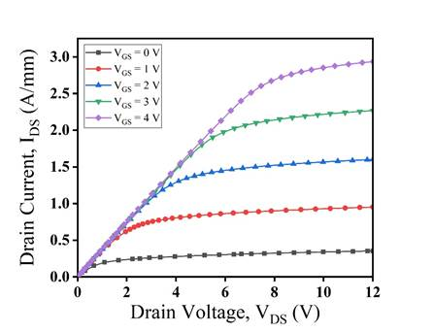
I_{DS}-V_{DS} characteristic for various gate bias V_{GS}
The drain current increases with higher VGS and VDS due to stronger polarization effects in the 2DEG.
The current ranges from 0.3 A/mm at VGS = 0 V to 2.9 A/mm at VGS = 4 V.
An Al₂O₃ gate dielectric is used to reduce impact ionization and prevent carrier leakage, improving device performance.
Fig.1: I_{DS}-V_{DS} characteristic for various gate bias V_{GS}

Slide 11
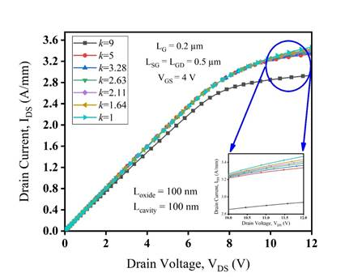
I_{DS}-V_{DS} characteristic for applied gate bias V_{GS} in DMSG device for different biomolecules (k = 1 to 9).
IDS-VDS characteristics are analyzed for DMSG devices with different biomolecules (k = 1 to 9).
The drain current is inversely proportional to the permittivity of the biomolecules.
Urease (k = 1.64) shows the highest drain current (3.430 A/mm), while Zein (k = 5) shows the lowest (3.336 A/mm).
Low-permittivity biomolecules result in higher drain current and transconductance due to peak electric field, velocity saturation, and better carrier confinement in the 2DEG.
Fig. 2: I_{DS}-V_{DS} characteristic for applied gate bias V_{GS} in DMSG device for different biomolecules (k = 1 to 9).

Slide 12
Table II: Drain current variation with the existence of biomolecules in the cavity.
Name of the Biomolecules (Permittivity) | I_{DS} at V_{GS} = 4 V, V_{DS} = 0 to 12 V for SMSG MOSHEMTs (A/mm) | I_{DS} at V_{GS} = 4 V, V_{DS} = 0 to 12 V for DMSG MOSHEMTs (A/mm)
Without Biomolecules (k = 9.1) | 1.536 | 2.936
Zein (k = 5) | 1.631 | 3.336
ChOx (k = 3.28) | 1.640 | 3.364
Biotein (k = 2.63) | 1.648 | 3.389
Glucose (k = 2.11) | 1.653 | 3.408
Urease (k = 1.64) | 1.660 | 3.430

Slide 13
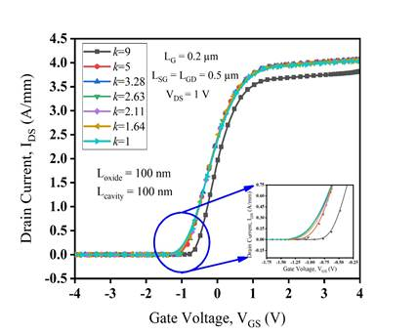
I_{DS}-V_{GS} characteristic for fixed drain bias V_{DS} = 1 V in DMSG device for different biomolecules (k = 1 to 9).
The IDS-VGS plot for DMSG at VDS = 1 V shows a positive shift in threshold voltage for biomolecules with higher permittivity.
The drain current decreases as the permittivity increases from 1.6 to 9.
Device sensitivity is inversely related to threshold voltage variations, which depend on the cavity thickness where biomolecules are embedded.
High drain current in DMSG devices is due to better gate controllability and strong carrier confinement in the 2DEG.
Fig. 3: I_{DS}-V_{GS} characteristic for fixed drain bias V_{DS} = 1 V in DMSG device for different biomolecules (k = 1 to 9).

Slide 14
Table III: Threshold voltage shift with the various biomolecules embedded in the cavity.
Name of the Biomolecules (Permittivity) | V_{th} at V_{DS} = 1 V, V_{GS} = - 4 to 4 V for SMSG MOSHEMTs (Volt) | V_{th} at V_{DS} = 1 V, V_{GS} = - 4 to 4 V for DMSG MOSHEMTs (Volt)
Without Biomolecules (k = 9) | -1.550 | -0.568
Zein (k = 5) | -1.725 | -0.854
Biotein (k = 2.63) | -1.747 | -0.871
Glucose (k = 2.11) | -1.750 | -0.896
Urease (k = 1.64) | -1.757 | -0.906
Airgap (k = 1) | -1.765 | -0.907

Slide 15
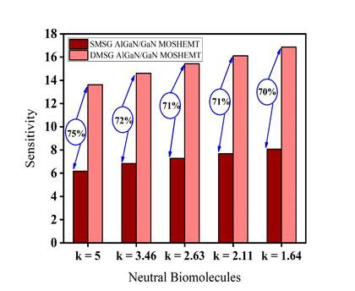
Sensitivity comparison between SMSG and DMSG structure with the consideration of neutral biomolecules
Low-permittivity biomolecules exhibit higher sensitivity compared to high-permittivity biomolecules.
DMSG devices show greater sensitivity than SMSG devices due to increased drain current and output conductance.
High sheet carrier density in DMSG devices enhances sensitivity by reducing leakage and suppressing short-channel effects (SCEs).
Urease (k = 1.64) achieves the highest sensitivity (70%) due to minimal leakage and strong carrier confinement.
Fig. 13: Sensitivity comparison between SMSG and DMSG structure with the consideration of neutral biomolecules

Slide 16
Conclusion
In this work, the impact of DMG Technique on GaN MOSHEMTS with different label-free biomolecules is analyzed and compared with conventional SMSG devices for improved performance and sensitivity. The band gap discontinuity and peak electric field significantly improve the channel's carrier confinement, leading to high sensitivity in this proposed device structure. The device sensitivity of DMSG devices is enhanced with 75% for (k = 5), 72% for (k = 3.46), 71% for (k = 2.63), 71% for (k = 2.11), 70% for (k = 1.64) in comparison with conventional SMSG device counterpart. Therefore, this proposed DMSG device structure can be a suitable candidate for high precision biosensing applications.

Slide 17
THANK YOU
Have a Great Day !

